Slide 1




Slide 2
Project for the Regional Advancement of Statistics in the Caribbean
PRASC
Component: Household Survey Infrastructure

Slide 3
Survey Sampling and Estimation
Denis Malo &
Wisner Jocelyn
Senior Methodologists, SSMD
September 30 – October 4
2019

Slide 4
Course objectives
This course will
provide you with the knowledge to understand sample surveys and the basics of probability sample designs
Tackle some of the peculiarities of Household Surveys
allow you to design and implement a survey

Slide 5
Course content
Introduction to survey design
Sample selection methods
Sources of error
Estimation and Weighting
Variance Estimation

Slide 6
Introduction
Planning a survey
Elements of survey design
Populations and frames

Slide 7
Planning a survey
Steps in planning the survey
  Definition of objectives: Why? Purpose
  Data requirements: What is needed?
  Analysis plan:
  Budget: How much?
  Time frame: How long
  Sample design

Slide 8
Planning a survey
Steps in planning the survey (cont’d)
  Data collection method
  Questionnaire design
  Field procedures
  Data processing
  Tabulation of results
  Evaluation and feedback

Slide 9
Designing and conducting the survey
Survey Operations: main steps in conducting a survey
  Design of the Questionnaire
  Design of the Sample
  Data collection
  Data processing
  Estimation and analysis
  Dissemination of results

Slide 10
Questionnaire design
  Content: What do I want to find out
  Test the questions before survey taking
  Question wording: keep it simple and…clear
    avoid biases
    logical flow
  Forms design
    sequencing and layout
    pre-coded for capture
  Pre-test
  Manuals

Slide 11
Design of the sample
Survey design
  Population
  Frame
  Survey Units
  Sample design
  Sample size

Slide 12
Elements of survey design
Sample design
  Sample selection strategy along with
  Estimation strategy
  Constitute the sample design
Estimation of sampling error to assess quality

Slide 13
Sample design
Sample selection method
  scientific selection of units to represent whole population
  must respect budget
Estimation method
  based on sampling method
Method for estimating precision (Variance)
  based on estimation method

Slide 14
Defining the population
Type of units to be surveyed
Defining characteristics
Geographic location of survey units
Reference period for survey (LFS reference week)

Slide 15
Examples of populations

Slide 16
Populations
Target population: the population for which information is required
Survey population: the population actually covered by the survey

Slide 17
Example
Labour Force survey
Target population: Persons residing in Canada
Survey population: residents in Canada
  excluding institutionalized population
  excluding persons with no fixed address

Slide 18
Populations
The target population and the survey population may be quite different
The original target population is often redefined to correspond to the population which can actually be surveyed
To do this, one must recognize the differences

Slide 19
Frames
Frame: also called a survey frame or sampling frame
  Provides access to population units
  Ideally is a complete and up-to-date list of all units

Slide 20
Frames
Mary Jones
Gary Sobers
Abdul Nesrallah
Bob White
Clive Lloyd
Barb Eaglesmith
Dottie West
Vivian Richards
Colin James
Michelle Wright
Brian Lara
B. J. Edward
David Foster
.........
.............

Slide 21
Example (LFS cnt’d)
Canadian Labour Force Survey
Target population: Persons residing in Canada
Sampling frame: Area Frame (List of Primary Sample units i.e) Geographic Areas

Slide 22
Frames
Is there a list?
Is it complete?
Is it up to date?

Slide 23
Frames
Types of frames
  List frame
    physical or conceptual list of units
  Area frame
    list or map of geographical areas
  Multiple frame
    combination of list and area frames
    or, two lists

Slide 24
Sources of frames
Administrative files
Directories (telephone and other)
Membership lists
Purchase lists
Conceptual frames
area frames time periods

Slide 25
Examples of list frames
Vital statistics registers
  birth/death registrations
Business Register
  from tax data
  used for most STC business surveys
Address Register
  from admin data (tax, phone billing, …)
  used by Census for mail-out and address verification, by the LFS and other surveys
Notes:
Updating the BR, very demanding

Slide 26
Examples of area frames
Lists and maps of administrative areas
  municipal boundaries
  school districts
Census geostatistical units
  CMAs, CDs, CSDs, DAs, etc.
  used in household surveys

Slide 27
Example of multiple frame
Canadian Community Health Survey
  list of phone numbers
  list of geographical areas (LFS clusters)

Slide 28
Frames
Qualities of a good frame
  Up to date
  Complete and without duplication
  No out-of-scope units
  Accurate
  Accessible and all in one place
  Distinct units sequentially numbered

Slide 29
Frames
Information on the frame should
  be useful for efficient sample design (stratification)
  facilitate sample selection
Information should permit accurate identification and location of each population unit
This is a necessary (but not sufficient) condition for the survey population to be equal to the target population

Slide 30
Frames
Frame affects
  definition of survey population
  method of data collection
  sample design
  survey results

Slide 31
Survey units
Sampling unit
  selected by sampling procedure
Respondent unit
  provides information
Reference unit
  about which information is obtained
Unit of analysis
  about which inferences are made

Slide 32
Example of survey units
Labour Force Survey
  Sampling unit dwelling
  Respondent unit adult household member
  Reference unit persons in households
  Units of analysis - individuals
  - families

Slide 33
Example of survey units
Fuel consumption survey
  Sampling unit Vehicle
  Respondent unit Owner or driver
  Reference unit Private use car
  Unit of analysis Private use car

Slide 34
Example of survey units
Household income survey
  Sampling unit dwelling
  Respondent unit head of census family
  Reference unit census family (nuclear)
  Unit of analysis economic family (extended)

Slide 35
Sample selection methods
1936 presidential elections in USA
Literary Digest Poll
  automobile registration and telephone subscriber lists
  10,000,000 questionnaires mailed out
  2,300,000 responses
Prediction
  Landon 55%
  Roosevelt 41%

Slide 36
Sample selection methods
Gallup’s “scientific” sample
6,500 persons
Prediction
  Landon 35%
  Roosevelt 64%
Result
  Landon 37%
  Roosevelt 61%

Slide 37
Sample selection methods
The most important factor is not the sample size, but the sample selection method
Every unit in the survey population must have a non-zero chance of being selected
The sample must be “representative” of the population

Slide 38
Sample selection methods
Representativity
  the sample must have characteristics similar to those of the population as a whole
How to select a representative sample without knowing the population?

Slide 39
Sample selection methods
Two possible approaches
Non-probability sampling
Probability sampling

Slide 40
Non-probability sampling
The individual’s (unit’s) selection probability is unknown
Commonly used methods
  Haphazard sampling
  Volunteer sampling
  Judgement sampling
  Quota sampling
  Focus groups

Slide 41
Non-probability sampling
Advantages
  speed
  low cost
Disadvantages
  no model for inference
Uses
  preliminary studies
  when population is well-known

Slide 42
Probability sampling
Every unit must have a calculable selection probability greater than zero
Sample is drawn using some method of random selection
The selection probabilities provide the estimation model for inference from the sample to the population
And an estimate of the sampling error can be calculated from the sample data

Slide 43
Probability sampling
Sample is guaranteed to represent the population well on average
That is, the expected value of the estimate is correct, in the sense of the mathematical expectation of a random variable

Slide 44
Probability sampling
There are many methods of probability sampling
We’ll study only the most widely used
  some are strictly methods of sample selection
  others are really methods of structuring the population (the sampling frame) to guarantee efficient sampling
A sample design may combine several of these methods

Slide 45
Probability sampling
Simple random sampling
Systematic sampling
Stratified sampling
Probability proportional to size sampling
Cluster sampling
Multi-stage sampling

Slide 46
Sampling: Set-up
We have a finite population U of size N from which we would want to obtain information on a given characteristic Y
From that population we can form the set Ω of all possible samples. That set has 2^{N} possible samples.
Let s be one of the sample from Ω. Consider a random variable S defined on Ω.
p(S = s) = p(s) is a probability measure. It is the probability of selecting the sample s.
We should note that p(s) defines completely the sampling plan or design.

Slide 47
Sampling: Set-up
For a given Statistic G (Total, ratio,and so on) defined on the sample we have:
1) and 2) above, require that the variable(s) of interest (for which we want the statistic) be available for the entire population
In the survey taking context, we will estimate using a subset from S or generally one sample s from S.

Slide 48
Sampling: Set-up
Working within the samples or equivalently with the elements of the samples, we define the inclusion probability of indivudual i as the sum of the probabilities of the samples to which the individual belong:
For a given linear statistic (say a total) and a given variable y (say Wages & Salary ) we have :
Or with

Slide 49
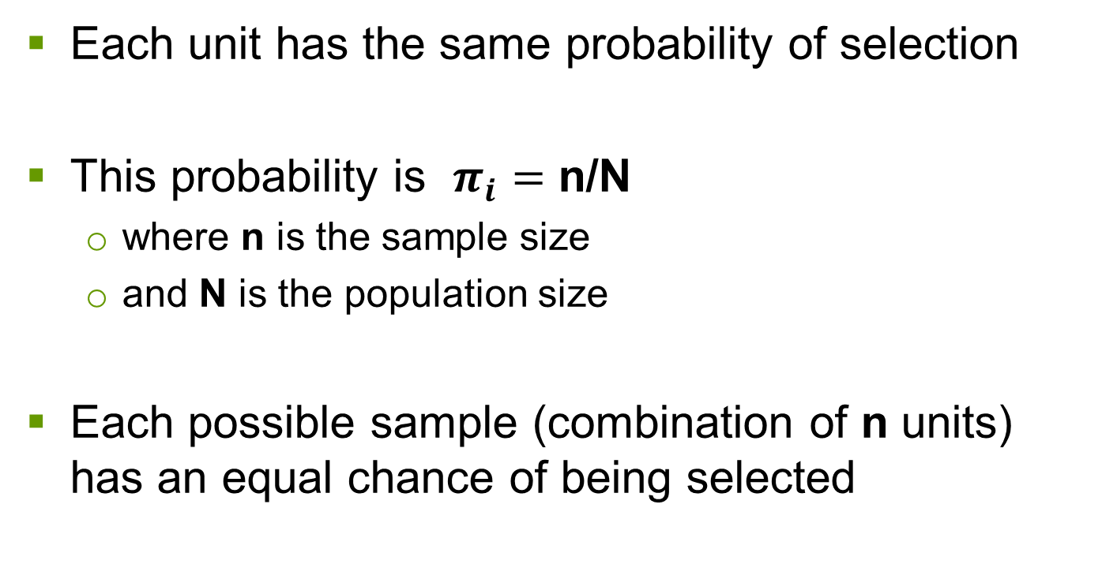
Simple random sampling (SRS)
Each unit has the same probability of selection
This probability is $π_{i}=$ n/N
  where n is the sample size
  and N is the population size
Each possible sample (combination of n units) has an equal chance of being selected

Slide 50
Simple random sampling
Method
  sampling frame must be a complete list
  units on list are numbered “1” to “N”
  pick “n” random numbers
  select corresponding units
Random selection may be done using
  table of random numbers
  computer algorithms

Slide 51
Simple random sampling
Advantages of SRS
  conceptually simple
  frame need only be a complete list of identifiable units
  estimation of population values is easy
  estimation of precision (standard error) is easy
  standard formulas for sample size and confidence intervals are based on SRS

Slide 52
Simple random sampling
Disadvantages of SRS
  can be tedious if n is large and numbers must be selected one by one
  makes no use of auxiliary information on the population
  requires a complete list of population units
  may have low precision (efficiency) compared to other methods
  in practice, one may obtain a “bad” sample

Slide 53
Simple random sampling: example
Population size: N = 54 dwellings
Sample size: n = 18
Sampling fraction: p = n / N = 18 / 54 = 1/3
All units have selection probability 1/3
18 random numbers are selected between 1 and 54
The corresponding dwellings are selected

Slide 54
1. 510 Rose Street 28. 513 Pitcher Plant Street
2. 511 Rose Street 29. 514 Pitcher Plant Street
3. 512 Rose Street 30. 515 Pitcher Plant Street
4. 513 Rose Street 31. 510 Arbutus Street
5. 514 Rose Street 32. 511 Arbutus Street
6. 515 Rose Street 33. 512 Arbutus Street
7. 510 Dogwood Street 34. 513 Arbutus Street
8. 511 Dogwood Street 35. 514 Arbutus Street
9. 512 Dogwood Street 36. 515 Arbutus Street
10. 513 Dogwood Street 37. 510 Trillium Street
11. 514 Dogwood Street 38. 511 Trillium Street
12. 515 Dogwood Street 39. 512 Trillium Street
13. 510 Crocus Street 40. 513 Trillium Street
14. 511 Crocus Street 41. 514 Trillium Street
15. 512 Crocus Street 42. 515 Trillium Street
16. 513 Crocus Street 43. 510 Lady Slipper Street
17. 514 Crocus Street 44. 511 Lady Slipper Street
18. 515 Crocus Street 45. 512 Lady Slipper Street
19. 510 Violet Street 46. 513 Lady Slipper Street
20. 511 Violet Street 47. 514 Lady Slipper Street
21. 512 Violet Street 48. 515 Lady Slipper Street
22. 513 Violet Street 49. 510 Lily Street
23. 514 Violet Street 50. 511 Lily Street
24. 515 Violet Street 51. 512 Lily Street
25. 510 Pitcher Plant Street 52. 513 Lily Street
26. 511 Pitcher Plant Street 53. 514 Lily Street
27. 512 Pitcher Plant Street 54. 515 Lily Street

Slide 55
Simple random sample
Rose Street
Mountain
Avens Avenue
Dogwood Street
Fireweed Avenue
Crocus Street
Violet Street
Pitcher Plant St
Arbutus Street
Trillium Street
Lady Slipper St
Lily Street

Slide 56
Simple random sample
Rose Street
Mountain
Avens Avenue
Dogwood Street
Fireweed Avenue
Crocus Street
Violet Street
Pitcher Plant St
Arbutus Street
Trillium Street
Lady Slipper St
Lily Street

Slide 57
Simple random sample
Rose Street
Mountain
Avens Avenue
Dogwood Street
Fireweed Avenue
Crocus Street
Violet Street
Pitcher Plant St
Arbutus Street
Trillium Street
Lady Slipper St
Lily Street

Slide 58
Simple random sampling
SRS may be done
  with replacement (SRSWR)
  without replacement (SRSWOR)

Slide 59
Simple random sampling
SRSWR
Select one unit
“Replace” it in the population
Select another, from the complete population
Continue until a sample of n units has been selected
The same unit may be selected more than once

Slide 60
Simple random sampling
SRSWOR
Select one unit
“Remove” it from the population
Select another unit from those remaining and remove it
Continue until n distinct units are obtained
Each unit can be selected only once
Method is more efficient than SRSWR
This is normally used in practice

Slide 61
Simple random sampling: example
Farm expenditure survey
Population of six farms (N = 6)
Survey objective: to estimate expenditures on fertilizer
Budget only permits a sample of two farms (n = 2)

Slide 62
Simple random sampling: example
Complete population (expenses unknown)
Farm Expenses
1 $ 26,000
2 470,000
3 63,800
4 145,000
5 230,000
6 12,500
Total 947,300

Slide 63
Possible Observed Estimated
samples expenses total
(1,2) 496,000 1,488,000
(1,3) 89,800 269,400
(1,4) 171,000 513,000
(1,5) 256,000 768,000
(1,6) 38,500 115,500
(2,3) 533,800 1,601,400
(2,4) 613,000 1,845,000
(2,5) 700,000 2,100,000
(2,6) 482,500 1,447,500
(3,4) 208,800 626,400
(3,5) 293,800 881,400
(3,6) 76,300 228,900
(4,5) 375,000 1,125,000
(4,6) 157,500 472,500
(5,6) 252,500 727,500
15 possible samples average 947,300 : unbiased

Slide 64
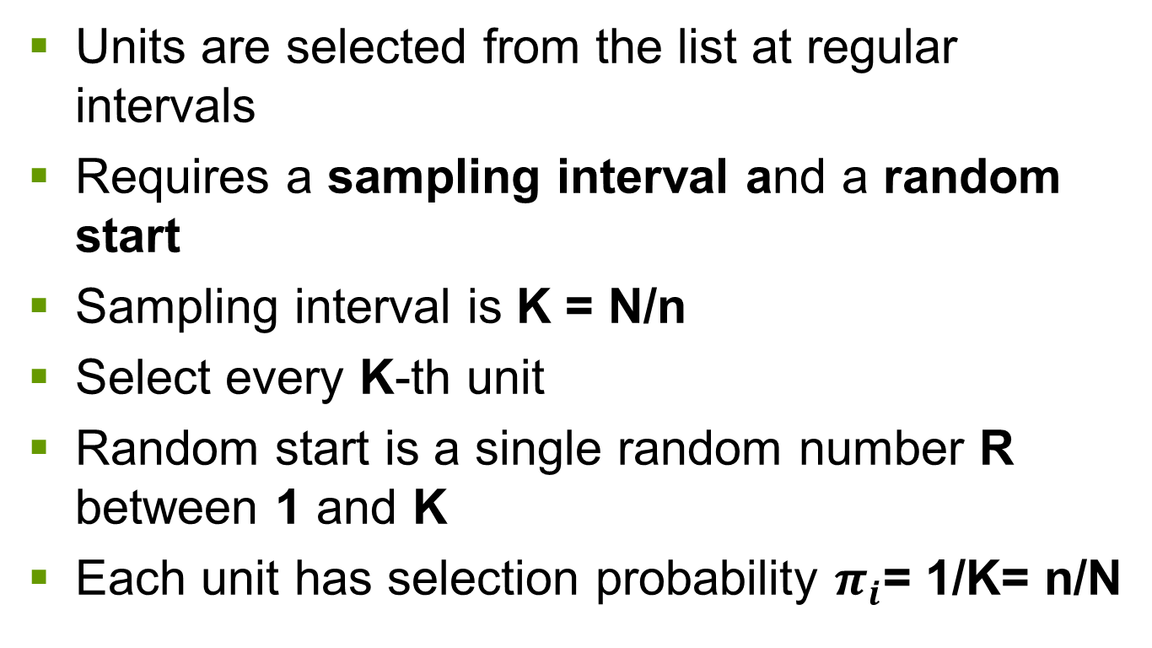
Systematic sampling
Units are selected from the list at regular intervals
Requires a sampling interval and a random start
Sampling interval is K = N/n
Select every K-th unit
Random start is a single random number R between 1 and K
Each unit has selection probability $π_{i}$= 1/K= n/N

Slide 65
1. 510 Rose Street 28. 513 Pitcher Plant Street
2. 511 Rose Street 29. 514 Pitcher Plant Street
3. 512 Rose Street 30. 515 Pitcher Plant Street
4. 513 Rose Street 31. 510 Arbutus Street
5. 514 Rose Street 32. 511 Arbutus Street
6. 515 Rose Street 33. 512 Arbutus Street
7. 510 Dogwood Street 34. 513 Arbutus Street
8. 511 Dogwood Street 35. 514 Arbutus Street
9. 512 Dogwood Street 36. 515 Arbutus Street
10. 513 Dogwood Street 37. 510 Trillium Street
11. 514 Dogwood Street 38. 511 Trillium Street
12. 515 Dogwood Street 39. 512 Trillium Street
13. 510 Crocus Street 40. 513 Trillium Street
14. 511 Crocus Street 41. 514 Trillium Street
15. 512 Crocus Street 42. 515 Trillium Street
16. 513 Crocus Street 43. 510 Lady Slipper Street
17. 514 Crocus Street 44. 511 Lady Slipper Street
18. 515 Crocus Street 45. 512 Lady Slipper Street
19. 510 Violet Street 46. 513 Lady Slipper Street
20. 511 Violet Street 47. 514 Lady Slipper Street
21. 512 Violet Street 48. 515 Lady Slipper Street
22. 513 Violet Street 49. 510 Lily Street
23. 514 Violet Street 50. 511 Lily Street
24. 515 Violet Street 51. 512 Lily Street
25. 510 Pitcher Plant Street 52. 513 Lily Street
26. 511 Pitcher Plant Street 53. 514 Lily Street
27. 512 Pitcher Plant Street 54. 515 Lily Street

Slide 66
Systematic sampling
Linear method
  Interval K = N/n
  Selection of R between 1 and K
  Selection of units R, R+K, R+2K, ..., R+(n-1)K

Slide 67
Systematic sampling: example
Population size: N = 54
Sample size: n = 18
Sampling interval: k = N / n = 54 /18 = 3
Random start: R = random # between 1 and 3
Suppose R = 2
Selected population units are numbers 2, 5, 8, 11, 14, 17, 20, 23, 26, 29, 32, 35, 38, 41, 44, 47, 50, 53

Slide 68
1. 510 Rose Street 28. 513 Pitcher Plant Street
2. 511 Rose Street 29. 514 Pitcher Plant Street
3. 512 Rose Street 30. 515 Pitcher Plant Street
4. 513 Rose Street 31. 510 Arbutus Street
5. 514 Rose Street 32. 511 Arbutus Street
6. 515 Rose Street 33. 512 Arbutus Street
7. 510 Dogwood Street 34. 513 Arbutus Street
8. 511 Dogwood Street 35. 514 Arbutus Street
9. 512 Dogwood Street 36. 515 Arbutus Street
10. 513 Dogwood Street 37. 510 Trillium Street
11. 514 Dogwood Street 38. 511 Trillium Street
12. 515 Dogwood Street 39. 512 Trillium Street
13. 510 Crocus Street 40. 513 Trillium Street
14. 511 Crocus Street 41. 514 Trillium Street
15. 512 Crocus Street 42. 515 Trillium Street
16. 513 Crocus Street 43. 510 Lady Slipper Street
17. 514 Crocus Street 44. 511 Lady Slipper Street
18. 515 Crocus Street 45. 512 Lady Slipper Street
19. 510 Violet Street 46. 513 Lady Slipper Street
20. 511 Violet Street 47. 514 Lady Slipper Street
21. 512 Violet Street 48. 515 Lady Slipper Street
22. 513 Violet Street 49. 510 Lily Street
23. 514 Violet Street 50. 511 Lily Street
24. 515 Violet Street 51. 512 Lily Street
25. 510 Pitcher Plant Street 52. 513 Lily Street
26. 511 Pitcher Plant Street 53. 514 Lily Street
27. 512 Pitcher Plant Street 54. 515 Lily Street

Slide 69
Systematic sampling
Rose Street
Mountain
Avens Avenue
Dogwood Street
Fireweed Avenue
Crocus Street
Violet Street
Pitcher Plant Street
Arbutus Street
Trillium Street
Lady Slipper Street
Lily Street

Slide 70
Systematic sampling
Population size: N = 54
Sample size: n = 10
Sampling interval: k = N / n = 54 / 10 = 5.4
Round down, i.e. k = 5
Random start: R = a random # between 1 and 5
Again suppose R = 2
With linear method, selected population units are numbers 2, 7, 12, 17, 22, 27, 32, 37, 42, 47

Slide 71
Systematic sampling
Now units 51-54 have no chance of selection
Two possibilities:
  take an 11th unit (unless random start had been 5, as there is no unit 55)
    in this case, unit 52 would be added to sample
  or
  use circular method

Slide 72
Linear Method
1. 510 Rose Street 28. 513 Pitcher Plant Street
2. 511 Rose Street 29. 514 Pitcher Plant Street
3. 512 Rose Street 30. 515 Pitcher Plant Street
4. 513 Rose Street 31. 510 Arbutus Street
5. 514 Rose Street 32. 511 Arbutus Street
6. 515 Rose Street 33. 512 Arbutus Street
7. 510 Dogwood Street 34. 513 Arbutus Street
8. 511 Dogwood Street 35. 514 Arbutus Street
9. 512 Dogwood Street 36. 515 Arbutus Street
10. 513 Dogwood Street 37. 510 Trillium Street
11. 514 Dogwood Street 38. 511 Trillium Street
12. 515 Dogwood Street 39. 512 Trillium Street
13. 510 Crocus Street 40. 513 Trillium Street
14. 511 Crocus Street 41. 514 Trillium Street
15. 512 Crocus Street 42. 515 Trillium Street
16. 513 Crocus Street 43. 510 Lady Slipper Street
17. 514 Crocus Street 44. 511 Lady Slipper Street
18. 515 Crocus Street 45. 512 Lady Slipper Street
19. 510 Violet Street 46. 513 Lady Slipper Street
20. 511 Violet Street 47. 514 Lady Slipper Street
21. 512 Violet Street 48. 515 Lady Slipper Street
22. 513 Violet Street 49. 510 Lily Street
23. 514 Violet Street 50. 511 Lily Street
24. 515 Violet Street 51. 512 LILY STREET
25. 510 Pitcher Plant Street 52. 513 LILY STREET
26. 511 Pitcher Plant Street 53. 514 LILY STREET
27. 512 Pitcher Plant Street 54. 515 LILY STREET

Slide 73
Systematic sampling
Circular method
  If N is not an exact multiple of n, the linear method may introduce bias
  Use K = [N/n], the largest whole number less than N/n
  Select R between 1 and N

Slide 74
Systematic sampling
Selected units are
R, R+K, R+2K, ..., R+(n-1)K
If j is such that result exceeds the list
R+(j-1)K > N ,
then go back to beginning and select unit
R+(j-1)K - N
That is, selection is done modulo N

Slide 75
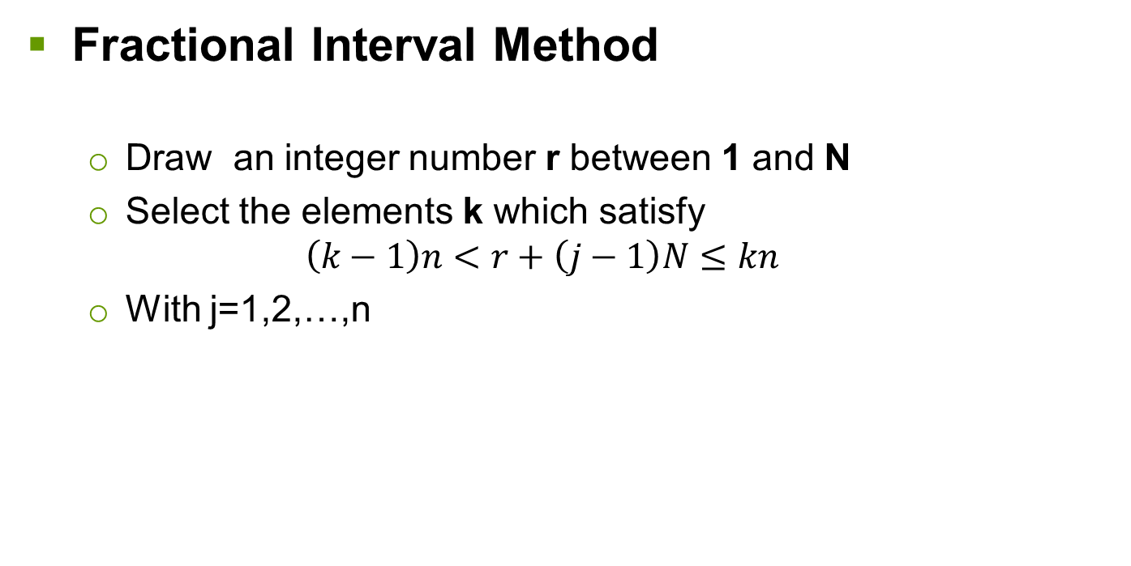
Systematic sampling
Fractional Interval Method
  Draw an integer number r between 1 and N
  Select the elements k which satisfy
  $$\left(k−1\right)n<r+\left(j−1\right)N≤kn$$
  With j=1,2,…,n

Slide 76
Systematic sampling
Population size: N = 54
Sample size: n = 10
Sampling interval: k = N / n = 54 / 10 = 5.4
Round down, i.e k = 5
Random start: R = a random # between 1 and 54
Treat your survey list as a circular list
suppose R = 33
Selected population units are numbers 33, 38, 43, 48, 53, 4, 9, 14, 19, 24

Slide 77
Circular Method
1. 510 Rose Street 28. 513 Pitcher Plant Street
2. 511 Rose Street 29. 514 Pitcher Plant Street
3. 512 Rose Street 30. 515 Pitcher Plant Street
4. 513 Rose Street 31. 510 Arbutus Street
5. 514 Rose Street 32. 511 Arbutus Street
6. 515 Rose Street 33. 512 Arbutus Street
7. 510 Dogwood Street 34. 513 Arbutus Street
8. 511 Dogwood Street 35. 514 Arbutus Street
9. 512 Dogwood Street 36. 515 Arbutus Street
10. 513 Dogwood Street 37. 510 Trillium Street
11. 514 Dogwood Street 38. 511 Trillium Street
12. 515 Dogwood Street 39. 512 Trillium Street
13. 510 Crocus Street 40. 513 Trillium Street
14. 511 Crocus Street 41. 514 Trillium Street
15. 512 Crocus Street 42. 515 Trillium Street
16. 513 Crocus Street 43. 510 Lady Slipper Street
17. 514 Crocus Street 44. 511 Lady Slipper Street
18. 515 Crocus Street 45. 512 Lady Slipper Street
19. 510 Violet Street 46. 513 Lady Slipper Street
20. 511 Violet Street 47. 514 Lady Slipper Street
21. 512 Violet Street 48. 515 Lady Slipper Street
22. 513 Violet Street 49. 510 Lily Street
23. 514 Violet Street 50. 511 Lily Street
24. 515 Violet Street 51. 512 Lily Street
25. 510 Pitcher Plant Street 52. 513 Lily Street
26. 511 Pitcher Plant Street 53. 514 Lily Street
27. 512 Pitcher Plant Street 54. 515 Lily Street

Slide 78
Systematic sampling: CAUTION!!!
Watch for: Periodicity - if the list has a cyclical element which corresponds to the sampling interval
Rose Street
Mountain
Avens Avenue
Dogwood Street
Fireweed Avenue
Crocus Street
Violet Street
Greenwood Blvd.
Memorial Ave.
Pitcher Plant Street
Arbutus Street
Trillium Street
Lady Slipper Street
Lily Street

Slide 79
Systematic sampling
Advantages
  Easy to select sample units
  Sample is well spread out over population
  Only requires list of units
  Estimates are easily calculated
  Frame may be available beforehand or compiled during the sampling process
  Out-of-scope units may be eliminated during sampling

Slide 80
Systematic sampling
Disadvantages
  Periodicity on the frame may give very bad estimates
  Complete list frame is required (or compiled during collection)
  Does not make use of any auxiliary information (unless sorting of list)
  Variance estimation is more difficult
  May not get exact sample size

Slide 81
Sample size
2000
10,000
How big should the sample be??
2% of pop
100
10% of pop
5% of pop

Slide 82
Factors affecting sample size
Requirements for data reliability (precision)
  key variables and desired outputs
  estimation breakdown
  population size
  variability of characteristics
  sampling method
  non-response
Operational constraints
  cost
  time
  human resources

Slide 83
Sample size
Key variables and desired outputs
  Decide on survey outputs
    totals
    proportions
    averages / medians
    other analyses
  Decide on levels of disaggregation
    geographical
    sub-populations or “domains”

Slide 84
Sample size
Determine required precision in terms of
  variance
  standard error
  coefficient of variation
  margin of error

Slide 85
Precision: Margin Of Error(MOE)
How much uncertainty can you live with?
How will results be used or how critical are the decisions to be made based on survey results?
Margin of error of 5% with 95% confidence level is common
MOE=Critical value x Standard Error

Slide 86
Sample size
Special case
  dichotomous variable (0-1, yes-no, etc.)
  proportion with the characteristic = p
  variance of estimate of p is
  V(p) = p*(1-p) / (n-1)

Slide 87
Sample size
Precision improves as sample size increases
Gains in precision are not directly proportional to increases in sample size
SAMPLE SIZE Margin of Error
50 + 14 %
100 + 10 %
400 + 5 %
1,000 + 3.2 %
( z = 1.96, p = 50%)

Slide 88
Sample size
What level of precision is required?
  Method 1: Key variables
    specify key estimates
    establish desired precision for each
    use the largest sample size indicated by these calculations
    efficient if the survey has few important variables

Slide 89
Sample size
  Method 2: breakdown of estimates
    determine the smallest breakdown for which a given level of precision is required
    calculate the sample size for this value
    useful if the survey is to produce many estimates at different levels

Slide 90
Sample size
Population size
  Effect on sample size is
    important for small populations
    moderate for medium-sized populations
    insignificant for very large populations

Slide 91
Sample size
Suppose that we have a preliminary estimate of roughly p = 0.5
And that we want the survey estimates to have a precision, in terms of the margin of error (at confidence level 95%), of no more than 0.05
That is, the standard error should be 0.025 or less
In these conditions, the required sample size, for various population sizes, is:

Slide 92
Sample size
Population Sample
50 44
100 80
500 222
1,000 286
5,000 370
10,000 385
100,000 398
1,000,000 400
10,000,000 400

Slide 93
Sample size
Variability of characteristics
  The more variability in the population, the larger the sample size needed to obtain the specified level of reliability
  Not generally known in advance
  Can be approximated from previous surveys or pilot studies
  Otherwise, assume maximum variability, e.g. 50% with characteristic & 50% without

Slide 94
Sample size
Sample design
  Basic calculations for sample size assume SRS
  Sample size formulas exist for more complex sample designs
  Stratification with appropriate allocation usually improves precision
  Clustering usually makes it worse
  Selection with unequal probabilities is more precise if the size measure used is well correlated with key survey variables

Slide 95
Sample size
Effect of non-response
  Variance (thus s.e. and m.e.) will be greater than planned
  The initial sample size may be increased to take into account the expected level of non-response
  This reduces the variance … but has no effect on any non-response bias

Slide 96
Sample size: example
Suppose you have 5,000 clients who used your services in the past 12 months and you want to estimate which proportion (p) of those clients are satisfied with the services they received. You plan to select a SRS from your list of clients. You think that a margin of error (m) of ± 5% for a 95% C.I. would be good enough for your needs (so z = 1.96 ≈ 2).
The steps to calculate the required sample size are as follows:

Slide 97
Sample size: example
Step 1: calculate the initial sample size
When estimating a proportion p under SRS, we saw that the variance of the estimate of p is
  V(p) = p(1-p) / (n-1)
  If n is reasonably large, we may use n in place of n-1
  Margin of error is m = z*s
    where z = 1.96 ~ 2
    and s is the standard error

Slide 98
Sample size: example
  That is, m² = z² *s²
  So s² = m² /z²
  But the variance is simply s² =p(1-p)/n
  Therefore m² /z² = p(1-p)/n
  And we have n = p(1-p)*z² /m²

Slide 99
Sample size: example
  We said we want m = .05 at most
  We don’t know the proportion, so we assume maximum variability (p=50%)
  and we simplify by using z = 2
  then n₁ = p(1-p)*z² /m²
  = .5 * .5 * 4 / .05²
  = 400
  Call this value n₁, the initial sample size

Slide 100
Sample size: example
  Step 2: adjust for population size (N)
  If N is not very large, we apply a finite population correction factor
  n₂ = n₁ * N/(N+n₁)
  In our case, N = 5000
  n₂ = 400 * 5000 / 5400
  = 370

Slide 101
Sample size: example
  Step 3: adjust for sampling method used
  For a complex sample design, we would have to multiple this by D, the design effect, giving
n₃ = D * n₂
  In the present case, we have D=1 (because used SRS)
  So n₃ = 370

Slide 102
Sample size: example
  Step 4: adjust for non-response
  If the expected response rate is r, we must divide by this value to have an initial sample size large enough to give the required number of responses
  Suppose that r = .70
  Then n₄ = n₃ / r
  = 370/.7
  = 529

Slide 103
Sample size: example
  Step 5: adjust for frame inefficiency
  Finally, we have to compensate for an out of date or imperfect frame (address change, out-of-scope units, etc.)
  Suppose that we expect that 10% of our clients will have moved, have incorrect contact information, etc. (so 90% “success”)
  Then n₅ = n₄ / 0.9 = 529 / .9 = 588
  This is the number of clients that we sample

Slide 104
Operational constraints
Sample size must make sense in terms of
Budget
Time
Other resources
DESIRED PRECISION
OPERATIONAL
CONSIDERATIONS

