Slide 1




Slide 2
Project for the Regional Advancement of Statistics in the Caribbean
PRASC
Component: Household Survey Infrastructure

Slide 3
Survey Sampling and Estimation
Denis Malo &
Wisner Jocelyn
Senior Methodologists, SSMD
September 30 – October 4
2019

Slide 4
Stratified sampling
Process of dividing population into homogeneous groups, called strata, and then selecting independent samples in each stratum
Stratification variables may be geographic and/or socio-economic, etc.
For Business surveys Stratification by Industrial classification (restaurants, garages), size measures (number of employes, Sales, etc.
Stratification is limited to the items of information available on the survey frame

Slide 5
Stratified sampling
SRS
Systematic
SRS
CENSUS

Slide 6
Stratified sampling
Four-step process
  Divide population into homogeneous, non-overlapping groups called strata
  Allocate the total sample size among strata
  Select samples independently in each stratum
  Estimate survey results within each stratum

Slide 7
Stratified sampling
Sum the stratum estimates to obtain estimated population totals
Do similar calculations for means and proportions, to obtain numerator and denominator

Slide 8
Stratified sampling
Stratification is not a sample selection method
It is a method which allows one to impose a structure on the population
The aim is to establish homogeneity within each stratum, and diversity (heterogeneity) between strata
  with respect to key survey variables

Slide 9
Stratified sampling
Strata may correspond to geographic, administrative, social or economic partitions
Stratification by size of unit is common in economic surveys
Stratification normally improves the precision of estimates, as compared to SRS; i.e., is more efficient

Slide 10
Stratified sampling
Example: Fuel Consumption Survey
  Objective: To study gasoline consumption of private cars in Canada
  Target population: Private-use cars
  Sampling frame: Vehicle registration file for each province
  Required outputs: Quarterly estimates at province level
  Sample: Approx. 750 vehicles per month

Slide 11
Stratified sampling
  Data collection: first contact by telephone, followed by mail-out of a “diary” to be filled in and mailed back
  Sample design: stratification, with SRS in each stratum
  Stratification: by province; year of manufacture; weight/wheelbase/number of cylinders (depending on province); urban/rural

Slide 12
Stratified sampling
Advantages
  Increases precision of overall population estimates, for given cost
  Guarantees that all important groups of the population are represented in the sample
  Permits efficient estimation at stratum level
  Operational or administrative convenience
  Uses auxiliary information
  May use any selection method in each stratum

Slide 13
Stratified sampling
Disadvantages
  Sampling frame is more complex
  Must know stratification variables for all elements on frame
  If allocation is far from optimum, can be less efficient than SRS
  Estimation is more complex
  Sample design is more costly to prepare
  Stratification efficient for one variable may not work well for others

Slide 14
Stratified sampling
Factors that influence efficiency
  choice of stratification variables
  number of strata
  determination of stratum limits
  allocation of sample to strata

Slide 15
Stratified sampling: example
Again consider the population of 6 farms
Suppose we now know the size of each farm in hectares
Again, we can only afford to select 2 units

Slide 16
Stratified sampling: example
Farm Hectares Expenses
1 50 $ 26,000
2 1000 470,000
3 125 63,800
4 300 145,000
5 500 230,000
6 25 12,500
Total 2000 947,300

Slide 17
Stratified sampling: example
Step 1 Divide population into 2 strata: large farms and small farms
Step 2 Allocate total sample (n=2) between strata [here, it must be 1 and 1]
Step 3 Select farm in each stratum
Step 4 Estimate expenses in each stratum and sum for total

Slide 18
Stratified sampling: example
Farm Hectares Expenses
Stratum 1 ≤200 ha.
1 50 $ 26,000
3 125 63,800
6 25 12,500
Stratum 2 >200 ha.
2 1000 470,000
4 300 145,000
5 500 230,000
Total 2000 947,300

Slide 19
Possible Observed Estimated
samples expenses total
(1,2) 496,000 1,488,000
(1,4) 171,000 513,000
(1,5) 256,000 768,000
(2,3) 533,800 1,601,400
(2,6) 482,500 1,447,500
(3,4) 208,800 626,400
(3,5) 293,800 881,400
(4,6) 157,500 472,500
(5,6) 252,500 727,500
9 possible samples average 947,300 : unbiased

Slide 20
Possible Estimation
samples SRS Stratified SRS
(1,2) 1,488,000 1,488,000
(1,3) 269,400
(1,4) 513,000 513,000
(1,5) 768,000 768,000
(1,6) 115,500
(2,3) 1,601,400 1,601,400
(2,4) 1,845,000
(2,5) 2,100,000
(2,6) 1,447,500 1,447,500
(3,4) 626,400 626,400
(3,5) 881,400 881,400
(3,6) 228,900
(4,5) 1,125,000
(4,6) 472,500 472,500
(5,6) 727,500 727,500
15 possible samples average 947,300 : unbiased

Slide 21
Sample allocation
Often, total sample is determined by budget and resources: how to best allocate to strata?
Fixed Sample size
  Sample size n allocated to the strata using a specific allocation (Proportional to size, Optimal allocation, Power allocation)
Fixed Coefficient of Variation (CV)
  Sample size n unknown
  Use the square of CV to derive allocation factors (proportion of units within each stratum)

Slide 22
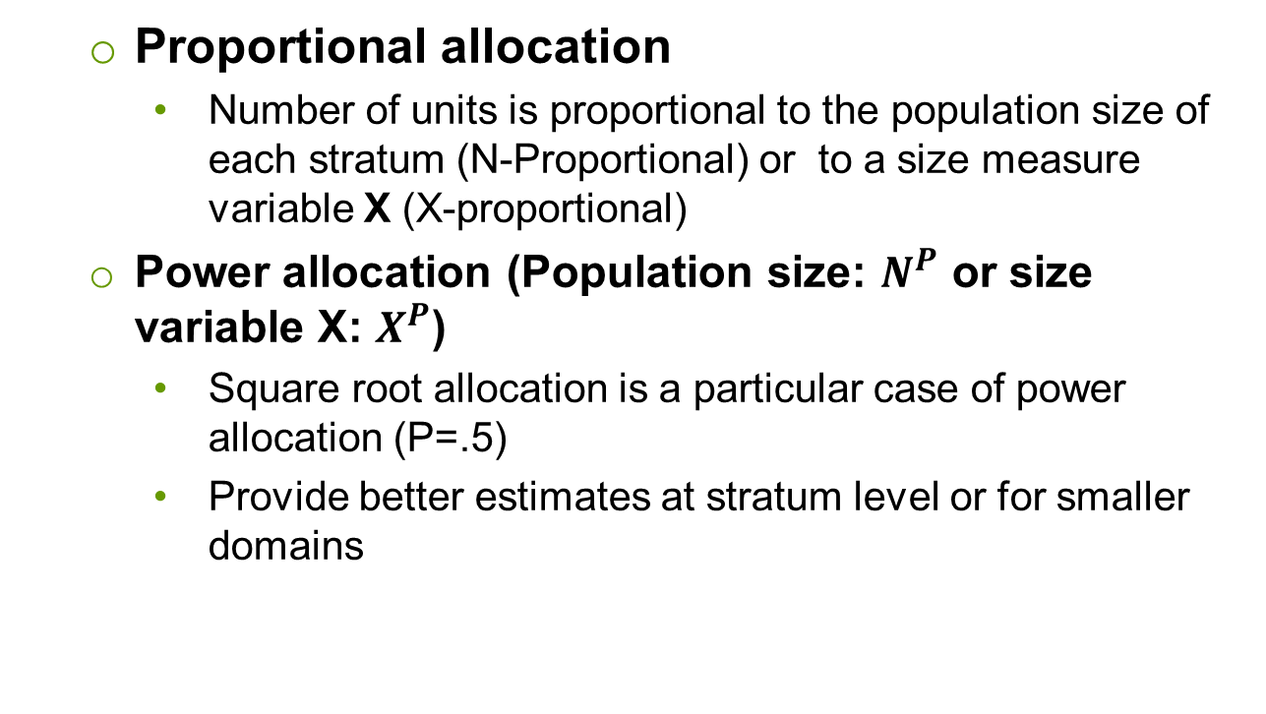
Sample allocation
  Proportional allocation
    Number of units is proportional to the population size of each stratum (N-Proportional) or to a size measure variable X (X-proportional)
  Power allocation (Population size: $N^{P}$ or size variable X: $X^{P}$)
    Square root allocation is a particular case of power allocation (P=.5)
    Provide better estimates at stratum level or for smaller domains

Slide 23
Sample allocation
Optimal allocation
  Considers cost and variance by stratum
  Strata with greater variance receive more sample units
  Strata with greater cost receive fewer sample units

Slide 24
Sample allocation
If no information is available on cost or variance, proportional allocation gives optimal precision for the whole population
  but small strata will have very imprecise estimates

Slide 25
Sample allocation
Allocation of an equal number of sample units per stratum gives equal precision for each stratum
  but precision is not optimal for whole population
One compromise, useful in practice, is allocation proportional to the square root of the stratum sizes

Slide 26
Sample allocation
Sub-populations
  small or localized sub-populations may be of special interest
  they may be made into strata if the sample frame permits
  they are then given sufficient sample units to provide reliable estimates

Slide 27
Sample allocation example
Note: Suppose n=2,000 to be allocated, SRS in each stratum, CV is for p=50%

Slide 28
Unequal-probability sampling
With SRS or other equal-probability methods, the same weight is given to every unit to ensure unbiased estimates
In many cases, it is desirable to use information on size of units (for example, for the 6 farms)
Because we suspect a positive correlation between size (in hectares) and certain variables (expenses in $)

Slide 29
Unequal-probability sampling
We could give each sample unit a weight inversely proportional to its size
Large farms would have small weights, and vice versa
Estimates should not be too far from the true value
We would have reduced the variance of the estimates

Slide 30
Unequal-probability sampling
Problem: the average over all possible estimates is not the true value
Estimation would be biased
Giving the same selection probability to every unit, but with size-based weights, would lead to over-estimation of the true value

Slide 31
Farm example
Farm Hectares Expenses
1 50 $ 26,000
2 1000 470,000
3 125 63,800
4 300 145,000
5 500 230,000
6 25 12,500
Total 2000 947,300

Slide 32
Farm example
SRS with n = 1 and equal weights (= 6)
Farm Hectares Est. expenses
1 50 $ 156,000
2 1000 2,820,000
3 125 382,800
4 300 870,000
5 500 1,380,000
6 25 75,000
Average 947,300

Slide 33
Farm example
SRS, but with weight proportional to 1/size
Farm Hectares Est. expenses
1 50 $1,040,000
2 1000 940,000
3 125 1,020,800
4 300 966,667
5 500 920,000
6 25 1,000,000
Average 981,245

Slide 34
PPS sampling
Solution to bias problem
  Give each unit (farm) a selection probability proportional to its size
  This is called “probability proportional to size” sampling (PPS)
  Then the natural weight is the inverse of the unit’s size, as we tried to “force” above
  And now the estimator is unbiased

Slide 35
PPS sampling
This option is attractive if some units are very large and many are quite small
It permits making selection more likely for units whose values contribute heavily to the total
These units then carry smaller sampling weights

Slide 36
Farm example
Farm Estimated Relative
expenses frequency
1 $1,040,000 50/2000
2 940,000 1000/2000
3 1,020,800 125/2000
4 966,667 300/2000
5 920,000 500/2000
6 1,000,000 25/2000

Slide 37
PPS sampling
Advantages
  Uses auxiliary information
  Can give dramatic improvements in precision
Disadvantages
  Requires a stable size measure for all units
  Estimation is more complex
  Variance estimation can be complicated

Slide 38
PPS sampling
When to use PPS?
  When a precise size measure is available
  When there is a strong correlation between size and the key variables of study

Slide 39
PPS sampling
Methods which use PPS
  PPS random
  PPS systematic
  PPS randomized systematic

Slide 40
PPS sampling
PPS random
  Calculate cumulative size measures
  Determine range corresponding to each unit
  Select random number between 1 and total size
  Select unit in corresponding range
  Repeat until n units are selected
  Can be done with or without replacement

Slide 41
PPS sampling
PPS systematic
  Calculate cumulative size measures
  Determine range corresponding to each unit
  Determine sampling interval K = total size / n
  Select random number between 1 and K
  Select unit in corresponding range
  Select units R, R+K, R+2K, etc.

Slide 42
PPS sampling
PPS randomized systematic
  Randomize order of units on frame
  Then do PPS systematic as described above

Slide 43
List samples and area samples
List sample
  Selected from a complete list of the units (elements) of the survey population
Area sample
  Involves selection of geographic areas
  Need to have an up-to-date list is limited to the selected areas only
  Methods include cluster sampling and multi-stage sampling

Slide 44
Cluster sampling
Process of selecting complete groups (clusters) of population units
Used when no satisfactory frame for individual population units exists
Used to reduce field costs
May be less precise than SRS because neighbouring units tend to be similar

Slide 45
Cluster sampling
A two-step process
  Group the population into clusters which can be identified on maps and in the field
  Select a sample of clusters and interview all elements within them

Slide 46
Cluster sampling
Clusters may be natural or artificial groupings
Possibly available from sources such as Census (blocks, EAs, etc.)
Survey designers may have to make them

Slide 47
Cluster sampling
Population is seen as hierarchy of units
  people live in dwellings
  dwellings make up blocks
  many blocks make up a town or city

Slide 48
Student survey
= Schools
= Students

Slide 49
Cluster sample
= Schools
= Students
= Sampled

Slide 50
Cluster sampling
Advantages
  Can be used even if there is no list of population units
  For personal interviews, travel time and cost are greatly reduced, particularly for rural populations
  Only a list of clusters is required
  Or the possibility of building one

Slide 51
Cluster sampling
Disadvantages
  Tendency of neighbouring units to be similar reduces efficiency
  For given n, estimates are less precise
  But if field costs are considered, the possibility of increasing n may (partially) offset this loss

Slide 52
Cluster sampling
If clusters are heterogeneous with respect to study variables, cluster sampling can even be more efficient than SRS
Example: cluster is household, variables are demographic
  each household is a “mini-population”

Slide 53
Cluster sampling
Considerations
  Must have access to a population which can be given a hierarchical structure
  Clusters must be as heterogeneous as possible
  Clusters must not be too large (to control interviewing costs and assignment sizes)
  Preferable to use many small clusters
  Clusters are selected with SRS, SYS or PPS

Slide 54
Cluster sampling
Lack of heterogeneity
  Neighbouring farms may resemble each other as to soil type, crops, etc.
  Households in neighbourhood may have similar income, houses or levels of education
In such cases, cluster sampling is inefficient

Slide 55
Cluster sampling
Sample design effect
  ratio of variance under the design to variance under SRS
  if a cluster design has twice the variance of SRS with the same sample size, the design effect is 2

Slide 56
Multi-stage sampling
Sample is selected in two or more stages
Hierarchy of units is required
Units (e.g. provinces) are selected at the first stage
Second-stage sub-samples are selected within each selected unit (e.g. cities)

Slide 57
Multi-stage sampling
First-stage units are called primary sampling units (PSUs)
Only PSUs selected at the first stage need to be subdivided into second stage units (SSUs)
  for a two-stage design, SSUs are population elements
and so on

Slide 58
Multi-stage sampling
A good sampling frame is required at each stage for the units to be selected at that stage
Generally, frames for higher-level units (PSUs) are more stable than those for lower-level units (farms, dwellings, ...)

Slide 59
Multi-stage sampling
Lower-level units are usually established on the basis of field counts
Method is useful when there is no population list
It may be the only way to access individuals
Cost-effective method of distributing the sample throughout the population

Slide 60
Multi-stage sample
= Schools
= Students
= Sampled

Slide 61
Stratified multi-stage sample
Elementary
schools
High schools
= Schools
= Students
= Sampled

Slide 62
Multi-stage sampling
Example: two-stage household sample
  First stage: selection of urban blocks with p₁ = 1/100
  Second stage: selection of dwellings with
  p₂ = 1/5
  Probability of selection for all dwellings in the city is
  p = p₁ * p₂ = 1/500

Slide 63
Multi-stage sampling
Hints for efficiency
  limit Stages: 2 stages should be the norm
  Make first stage cluster small: pick more clusters (with fewer units within each selected cluster
  for a fixed sample size:
    schools; classes within schools; students within classes
    schools; students within schools
    classes; students within classes

Slide 64
Multi-stage sampling
Advantages
  Collection is concentrated and costs reduced
  Can be used without complete frame
  Selection methods can vary from one part of the frame to another

Slide 65
Multi-stage sampling
Disadvantages
  Design effect and loss of efficiency
  Construction of sampling frame is complex
  Estimation becomes more complex

Slide 66
Multi-stage sampling
General procedure
  preparation of list of PSUs
  stratification, sample allocation and selection of PSUs
  preparation of lists of SSUs within PSUs selected for the sample
  stratification, sample allocation and selection of SSUs
  etc.

Slide 67

You can contact the PRASC team at:
statcan.prasc-prasc.statcan@canada.ca

