Slide 1


1

Slide 2
Project for the Regional Advancement of Statistics in the Caribbean
PRASC
Component: Household Survey Infrastructure

Slide 3
Survey Sampling and Estimation
Denis Malo &
Wisner Jocelyn
Senior Methodologists, SSMD
September 30 – October 4
2019

Slide 4
Variance Estimation
September 2019

Slide 5
Objectives
Explore methods that can be used to help estimate the variance in the context of the multi-stage designs
  We will cover variance estimation in general
  We will illustrate how different methods can be compared

Slide 6
Overview
Preliminaries on survey sampling
Variance estimation methods
Bootstrap methods
  Desired properties of bootstrap methods in the survey sampling set-up
  Rao-Wu-Yue re-scaled bootstrap
  Poisson bootstrap
Conclusion

Slide 7
Introduction
We’ve conducted a survey and we wish to estimate parameters such as totals, averages, medians, and so on for different variables (income, expenses, unemployment, and so on).
There is a need to provide a quantitative assessement of the quality of the estimates produced.

Slide 8
Introduction: Reminder
One of the most widely used measure of quality in survey sampling is the coefficient of variation defined as the ratio of the square root of the variance of an estimates over the estimates.
  Another quality measure is the confidence intervals for an estimated parameter defined as:
  Both measures require the estimation of variance of potentially complex parameters

Slide 9
Introduction: Main Goal
Given the complexity of the designs used (multi-stage, pps) it is not possible to derive exact formulas for the variance. Instead, we will explore the use of replication techniques with emphasis on bootstrap methods that can be adapted to the situation
We will begin however with some probabilistic reminders on survey sampling

Slide 10
Preliminaries
We have a finite population U of size N from which we would want to obtain information on a given characteristic Y
From that population we can form the set Ω of all possible samples. That set has 2^{N} possible samples.
Let s be one of the sample from Ω. Consider a random variable S defined on Ω.
p(S = s) = p(s) is a probability measure. It is the probability of selecting the sample s.
We should note that p(s) defines completely the sampling plan or design.

Slide 11
Preliminaries
For a given Statistic G (Total, ratio,and so on) defined on the sample we have:
i)
ii)
i) and ii) above, require that the variable(s) of interest (for which we want the statistic) be available for the entire population
In the survey taking context, we will estimate using a subset from S or generally one sample s from S.

Slide 12
Sampling stage
Estimation stage
U: population
Probability sample design
Probability
of selection
Sample
Estimate
Sampling variance
1
2
3
…
k
…
p(∙)
N
…
…
…
…
…
Population units -unknown
values
…
…
…
…
…
θ: unknown
parameter
Sample units -
measured values

Slide 13
Preliminaries
Working within the samples or equivalently with the elements of the samples, we define the inclusion probability of indivudual i as the sum of the probabilities of the samples to which the individual belong:
For a given linear statistic (say a total) and a given variable y (say Wages & Salary ) we have :
Or with

Slide 14
Preliminaries
The quality of depends on how well it would behave from one sample s to another
Another way of putting it is to look at its variance that is given as:
With being the probability that k and l are both selected in the sample.
Since the variance require complete knowledge of Y from U the population, we consider its estimates based on the sample.

Slide 15
Preliminaries
A variance estimator is obtained as:
A sampling strategy is the combination of a defined sampling plan with an estimator i.e)
Clearly we want strategies where
And is as small as possible
  Calibration is one way of reducing the variance
  Another way is through stratification

Slide 16
2. Variance estimation methods

Slide 17
Variance estimation: Paths
We could use the following to achieve our goals:
  We can use « textbook » formulas wherever the design can be assumed to be simple
  We can linearize when the parameters are non-linear
  We can use one of the replication techniques advocated in the litterature
Statistics Canada • Statistique Canada
23/09/2019

Slide 18
“Textbook” approach
When the design and the estimator are simple (say variance for a total for a stratified srs) variance formula for the estimator can be derived algebraïcally.
An estimator of this variance is then worked out by deriving formulas, using some estimation principle such as the π-expansion principle.
This variance estimator depends obviously on the design and the form of the parameter.
This works ONLY with simple designs, simple parameters and simple estimators.
Statistics Canada • Statistique Canada
23/09/2019

Slide 19
Variance estimation Weighting model
1) Derive design weight
2) Non-response adjustment
3) Other adjustments
4) Calibration
A sound variance estimation process needs to take each of these steps into consideration because each one could potentially influence the level, variability and/or bias of the sample
Ideally, we would like to take into account all the above steps and possibly incorporate them all into one formula like a Total Squared Error formula (Sampling variance with modified variability due to other statistical adjustments made to the sample)
Unfortunately, there is no simple solution to that problem
Statistics Canada • Statistique Canada
23/09/2019

Slide 20
Variance estimation
One simple solution is to assume a simpler design than what was used:
Example: For a given survey where the design was stratified multistage pps, assume at the variance estimation stage that it was srs without replacement at stage 1 and consider only stage 1 variability. Variance is approximated as:
Here is an estimate of y using second stage weights, by stratum (h)
Statistics Canada • Statistique Canada
23/09/2019

Slide 21
Variance estimation
Solution 1) Unfortunately is not practical
a) The variance estimates could go in any direction (in terms of bias) depending on the statistics to be produced
b) For Intrinsic non-linear parameters such as regression coefficients, order statistics such as quantiles there are no possible ways to obtain the variance but through linearization (at great cost in terms of formula derivation and precision)
But, linearization can sometimes be useful when the set of parameters for which we want estimates are limited and are non-linear
Statistics Canada • Statistique Canada
23/09/2019

Slide 22
Taylor linearization
When the complexity comes from the parameter(non-linear parameters such as a regression coefficient for instance) we can use an approximation in lieu of the actual estimator. Such approximation is obtained through Taylor linearization. Taylor linearization goes hand to hand with the “text book” approach
First assume that a “text book” variance formula can be used for the chosen design
Then
: values of a linear variable L associated with
Statistics Canada • Statistique Canada
23/09/2019

Slide 23
Taylor linearization
Clearly,
Next , we obtain an “approximate” estimator of the variance via the algebraic (“text book”) method under
Statistics Canada • Statistique Canada
23/09/2019

Slide 24
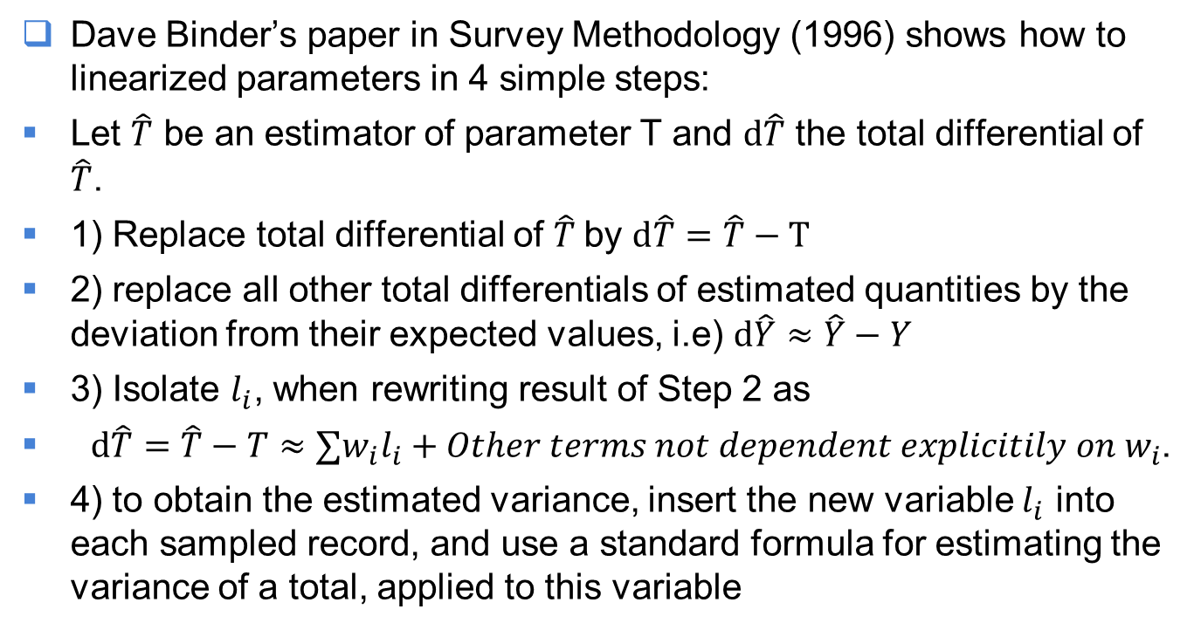

Taylor linearization: Binder’s recipe to obtain $l_{i}$
Dave Binder’s paper in Survey Methodology (1996) shows how to linearized parameters in 4 simple steps:
Let $\hat{T}$ be an estimator of parameter T and $d\hat{T}$ the total differential of $\hat{T}$.
1) Replace total differential of $\hat{T}$by $d\hat{T}=\hat{T}−T$
2) replace all other total differentials of estimated quantities by the deviation from their expected values, i.e) $d\hat{Y}≈\hat{Y}−Y$
3) Isolate $l_{i}$, when rewriting result of Step 2 as
$d\hat{T}=\hat{T}−T≈∑w_{i}l_{i}+Other terms not dependent explicitily on w_{i}$.
4) to obtain the estimated variance, insert the new variable $l_{i}$ into each sampled record, and use a standard formula for estimating the variance of a total, applied to this variable
Statistics Canada • Statistique Canada
23/09/2019

Slide 25
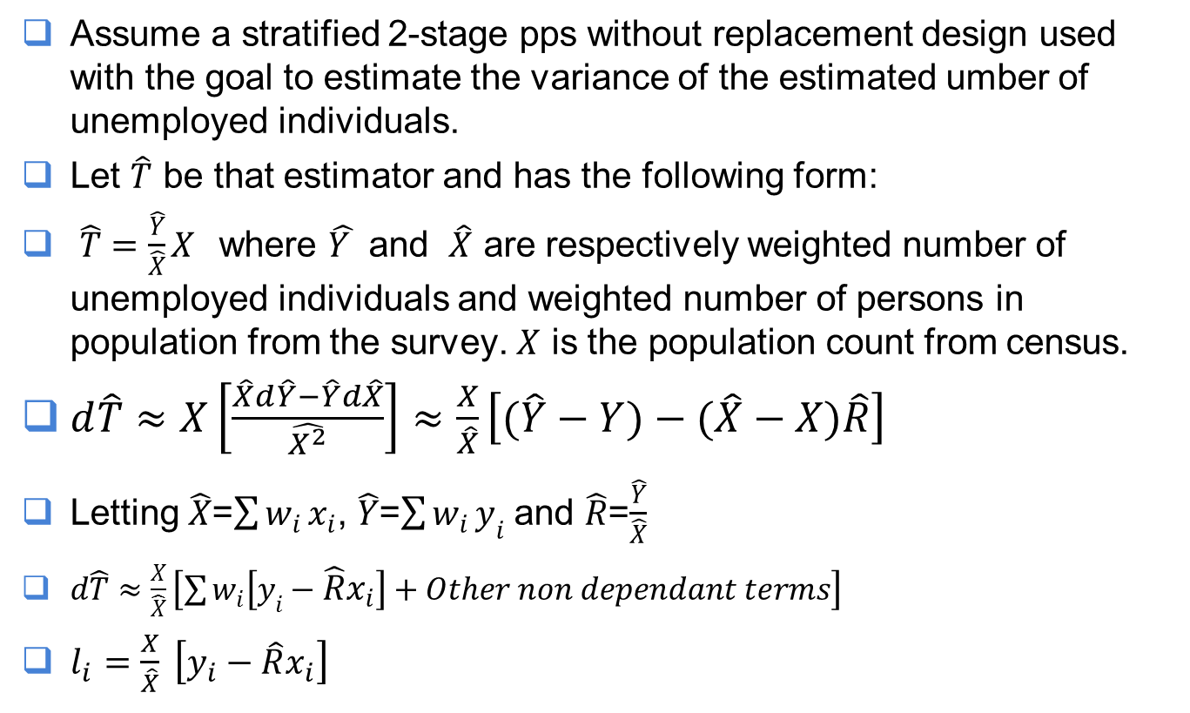
Taylor linearization: an example
Assume a stratified 2-stage pps without replacement design used with the goal to estimate the variance of the estimated umber of unemployed individuals.
Let $\hat{T}$ be that estimator and has the following form:
$\hat{T}=\frac{\hat{Y}}{\hat{X}}X$ where $\hat{Y }$ and $\hat{X}$ are respectively weighted number of unemployed individuals and weighted number of persons in population from the survey. $X$ is the population count from census.
$d\hat{T}≈X\left[\frac{\hat{X}d\hat{Y}−\hat{Y}d\hat{X}}{\hat{X^{2}}}\right]≈\frac{X}{\hat{X}}\left[(\hat{Y}−Y)−(\hat{X}−X)\hat{R}\right]$
Letting $\hat{X}$=$\sum{w_{i}}x_{i}$, $\hat{Y}$=$\sum{w_{i}}y_{i}$ and $\hat{R}$=$\frac{\hat{Y}}{\hat{X}}$
$d\hat{T}≈\frac{X}{\hat{X}}\left[\sum{w_{i}\left[y_{i}−\hat{R}x_{i}\right]+Other non dependant terms}\right]$
$l_{i}=\frac{X}{\hat{X}} \left[y_{i}−\hat{R}x_{i}\right]$
Statistics Canada • Statistique Canada
23/09/2019

Slide 26
Replication techniques
Replication methods involve sub-sampling from the selected sample
From each sub-sample or replicates we obtain an estimation of the parameter of interest.
The variance of the estimates is “derived” from the variability of the replicates.
A number of methods are available :
  Random groups, Balance replicated, Jackknife, Bootstrap and so on.
Focus on the bootstrap with a glimpse of the Jackknife
Statistics Canada • Statistique Canada
23/09/2019

Slide 27
Replication techniques: Overview
Our goal is to obtain the variance estimates of a parameter
From a sample s of size n, we form B subsamples of size , b=1,2,---,B
Using each of the subsample we estimate the parameter and we obtain
The variance is usually obtained as
Statistics Canada • Statistique Canada
23/09/2019

Slide 28
Replication technique: The Jackknife
Jackknife
  From the original sample form B groups using the complement (all the sample members included except for the group b itself). Define:
  Where is the estimate of the parameter obtained when group b is excluded.
  We estimate by
Statistics Canada • Statistique Canada
23/09/2019

Slide 29
Replication technique: The Jackknife
For multistage design the Jackknife is carried-out by deleting an entire cluster at a time
The Jackknife variance estimator is not convergent for non-smooth statistics such as medians
Statistics Canada • Statistique Canada
23/09/2019

Slide 30
3. Bootstrap methods

Slide 31
Bootstrap
Introduced in 1970 by B. Efron
Developed under the assumption that the observations are IID.
Given a sample of n observations, draw sub-samples with replacement from that sample
Each bootstrap sample represents a possible outcome from the population
The bootstrap “tracks” the distribution of the sample or another way of putting it : The moments of the sample
The population is to the original sample what the original sample is to the bootstrap samples

Slide 32
Bootstrap:IID implementation
Given a sample of size n, with
Let be the outcome of a statistic T.
Let M be the number of bootstrap samples to be generated
Draw a sample of size n with replacement (swr) from let that sample be for each evaluate T.
Repeat previous step M-times
Statistics Canada • Statistique Canada
23/09/2019

Slide 33
Bootstrap:IID implementation
Let be the M-set obtained after M-draws
  This set is known as the Empirical Bootstrap Distribution (EBD)
  When M is large the EBD provides a good approximation of the bootstrap distribution of T
  The EBD mimics the distribution of the sample and under certain conditions on the sample the distribution of the Population
Statistics Canada • Statistique Canada
23/09/2019

Slide 34
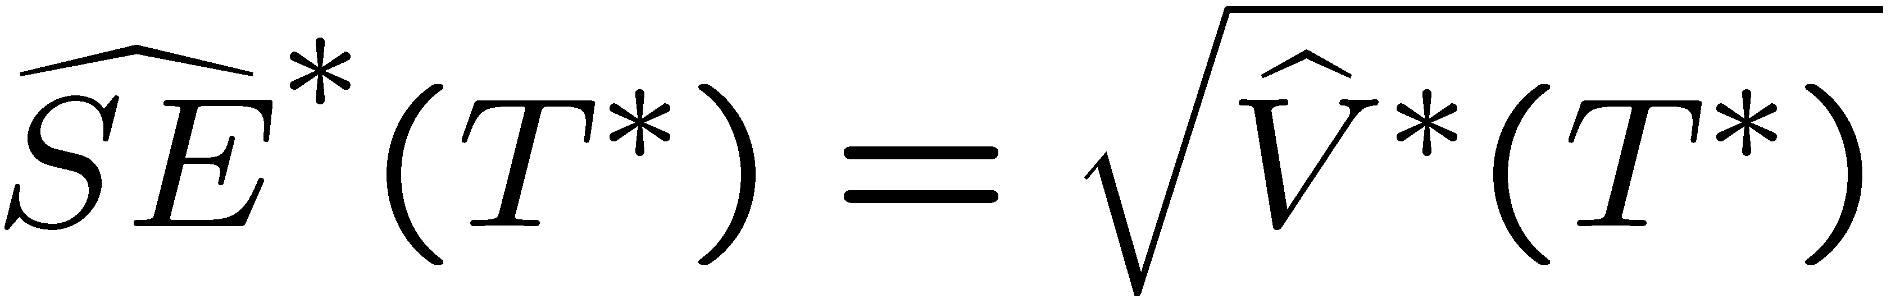
Illustration
Mean of Bootstrap samples
Is the variance estimates of T with standard deviation
given below

Slide 35
How good is the method?
Question: How good is the bootstrap?
We have that

Slide 36
Example
Original sample (n = 5)
23, 28, 30, 50, 61
Bootstrap sample (B = 5000)
1
2
3
.
.
5000
28, 50, 30, 23, 23
30, 50, 50, 61, 28
61, 23, 30, 23, 28
.
.
28, 50, 30, 61, 30

Slide 37
Uncertainty around the mean
Original sample(n = 5)
23, 28, 30, 50, 61
= 38.4
Bootstrap sample (B = 5000)
1
2
3
.
.
5000
28, 50, 30, 23, 23
30, 50, 50, 61, 28
61, 23, 30, 23, 28
.
.
28, 50, 30, 61, 30

Slide 38
Bootstrap in sample survey
The Bootstrap method is used mainly to obtain an estimate of the variance for some complex survey parameters and/or designs
As mentioned earlier it is understood that the design of IHS makes it nearly impossible to use any other techniques but a replication techniques and possibly the only suitable one might be the bootstrap.
Unfortunately, the fact that the IHS design has
  a three stage pps component with large sampling fraction makes direct application of available bootstrap methods “trickier”

Slide 39
Bootstrap in sample survey
While the use of the bootstrap is quite straightforward in the classic case
Using the same recipe in survey sampling will not work
Let us look at the simplest possible case. Say we want to estimate the variance of a total :
if we generate with-replacement samples and directly recalculate a bootstrap estimate and proceed as before, we will find that the bootstrap variance is not consistent (it does not converge to the usual variance estimates).
For the bootstrap method to be useful in survey sampling it needs to be adapted

Slide 40
Bootstrap in sample survey
The adaptation for survey sampling consist of modifying the weight in such a way that the bootstrap variance estimates become a consistent variance estimator
The condition for a good bootstrap procedure is to find
A random adjustment such that
Is a bootstrap replicate and that the bootstrap moments (*) under the srs with replacement match the moments of the sample. Mathematically:
All the methods considered later will match at least the first 2 moments (most will even match the third moment)

Slide 41
Bootstrap in sample survey
Advantages
  No formula derivation.
  Works for many statistics as well as for non-smooth functions
Disadvantages
  Computer intensive.
  Some of the theoretical aspects still needs to be studied.
  Over-estimation of the variance in some instances
A variety of methods are available

Slide 42
Bootstrap in sample survey
Rao-Wu-Yue Re-scaling:
  Rao and Wu (1987) Rao, Wu and Yue(1992).
  This adaptation works well for 2-stage designs
  Because of the with-replacement strategy, there is a requirement to have negligible first stage sampling fraction
  However, a without replacement version does exit.
  Single adjustment to the weight

Slide 43
Bootstrap in sample survey
Poisson bootstrap:
  Beaumont and Patak (2010)
  Design for Poisson sampling but seems to work for other designs
  Simple to implement, only requires a random adjustment to the weights no sub-sampling involved
  The method should be less suited for fixed sample size design though the results obtained for StatCan surveys seems to indicate otherwise

Slide 44
Sampling stage
Estimation stage
U: population
Probability sample design
Probability
of selection
Sample
Estimate
Sampling variance estimate
1
2
3
…
k
…
p(∙)
N
…
Population units -unknown
values
…
θ: unknown
parameter
Sample units -
measured values

Slide 45
Bootstrap procedure:Rao-Wu-Yue
For b=1 to B
  In each stratum an SRSWR of size of PSUs is selected from the n_{h} PSUs in sample s. Let’s refer to this sample as s_{(b)}, the b^{th} bootstrap sample.
  Given the number of times the PSU-hi is selected, the bootstrap weights are calculated as

Slide 46
Bootstrap procedure:Rao-Wu-Yue
  The choice m_{h}=n_{h}-1 PSUs from the n_{h} PSUs in sample s yields.
  The weights above have the advantage of being always greater or equal to zero.

Slide 47
Poisson bootstrap
For b=1 to B
Generate a set of random adjustment
Calculate the bootstrap weights as :
For a linear estimator , a bootstrap procedure is defined as a random mechanism ( ) on the adjustments such that
and
With , and
Beaumont and Patak (2010) state conditions for existence of for a given sample design

Slide 48
PoissonBootstrap
The Poisson method:
  Let
  With
  Finally define the bootstrap weights as:

Slide 49
Bootstrap procedure
The bootstrap estimator of the variance is given by
Where is evaluated using the bootstrap weights based on each of the previous methods described

Slide 50
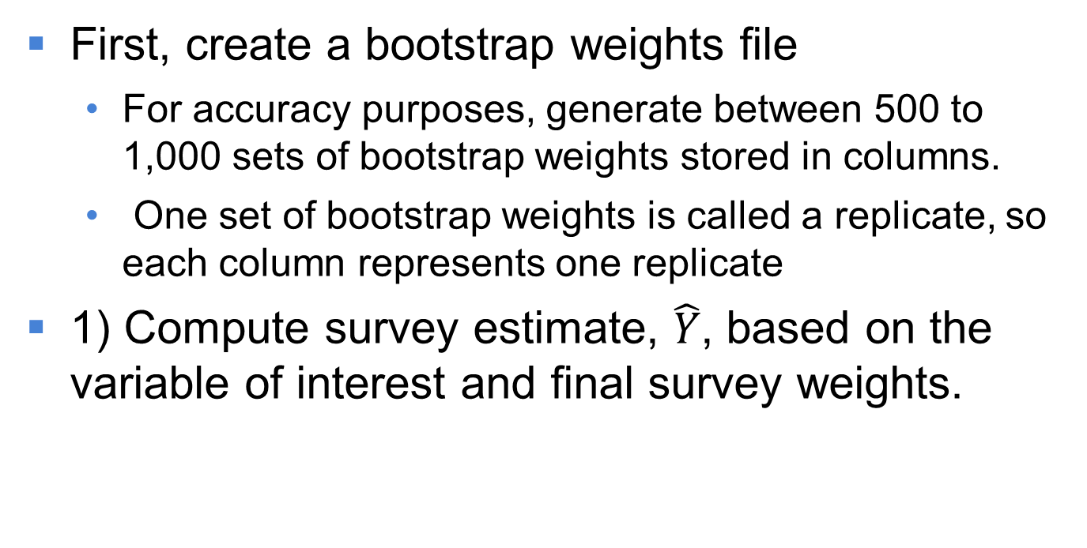
How to implement a bootstrap procedure
First, create a bootstrap weights file
  For accuracy purposes, generate between 500 to 1,000 sets of bootstrap weights stored in columns.
  One set of bootstrap weights is called a replicate, so each column represents one replicate
1) Compute survey estimate, $\hat{Y}$, based on the variable of interest and final survey weights.

Slide 51
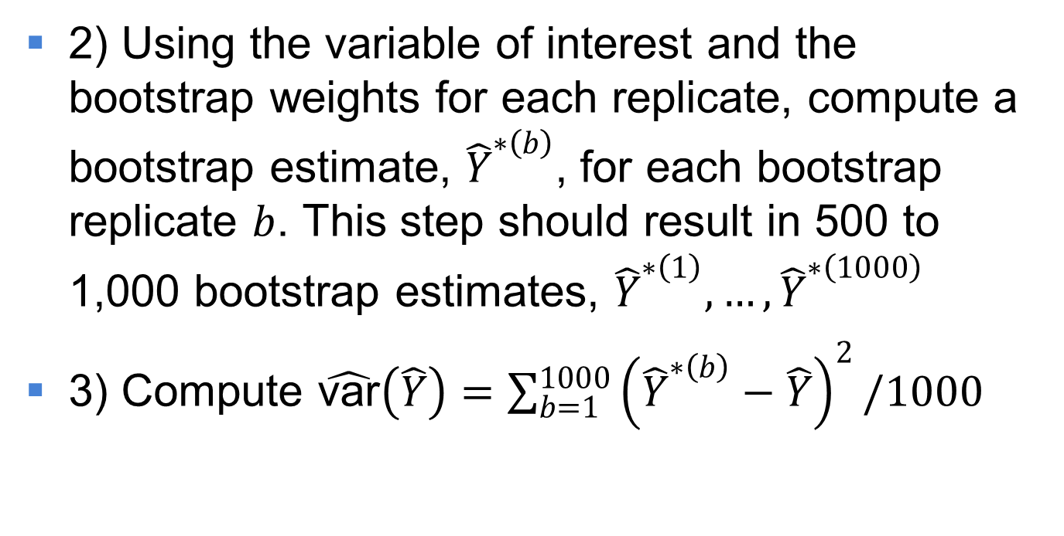
How to implement a bootstrap procedure
2) Using the variable of interest and the bootstrap weights for each replicate, compute a bootstrap estimate, ${\hat{Y}}^{∗\left(b\right)}$, for each bootstrap replicate $b$. This step should result in 500 to 1,000 bootstrap estimates, ${\hat{Y}}^{∗\left(1\right)}, …, {\hat{Y}}^{∗\left(1000\right)}$
3) Compute $\hat{\text{var}}\left(\hat{Y}\right)=\sum_{b=1}^{1000}{{\left({\hat{Y}}^{∗\left(b\right)}−\hat{Y}\right)}^{2}/1000}$

Slide 52
You can contact the PRASC team at:
statcan.prasc-prasc.statcan@canada.ca

